Slide 1
Apply AI: RAG
Retrieval Augmented Generation

Slide 2
LLM Limitations
Outdated Knowledge: Trained on data from months/years ago
No Access to Your Data: Can't know about your company docs or files
Hallucinations: Sometimes "makes up" confident-sounding answers
No Sources: Doesn't tell you where it got the information

Slide 3
RAG
RAG = Giving the AI a reference library before answering
Instead of: "Just answer based on what you know"
RAG does: "Here's your research materials. Now answer!"
Like giving a student books before asking them a test question

Slide 4
Indexing (Setup)
You prepare your knowledge library:
Upload your documents (PDFs, websites, company docs)
Split them into chunks (small pieces)
Convert chunks → vectors (numbers representing meaning)
Store in a vector database for fast searching

Slide 5
Retrieval (Search)
When user asks a question:
Convert question into vector
Search database for similar documents
Grab the top matching chunks (like library results)
These become the "context" for the AI

Slide 6
Generation (Answer)
The LLM creates the final answer:
Send question + retrieved documents to LLM
LLM reads the context and generates answer
Answer is based on real data, not guessing
Can cite sources from retrieved documents

Slide 7
Human Resources Bot
User asks: "What's our vacation policy?"
Search: Find "vacation policy" docs from company handbook
Retrieve: Get exact policy chapters
Generate: AI creates clear answer using the official doc
Source: Cites "Employee Handbook, Section 5"

Slide 8


Choose your tools

Slide 9
Apply AI: RAG
Choose your tools

Slide 10
LLM Studio Instalation
Windows Tutorial -> https://www.youtube.com/watch?v=ygUEbCpOOLg Linux Tutorial -> https://www.youtube.com/watch?v=Bhzpph-OgXU
MacOS Tutorial -> https://www.youtube.com/watch?v=FfsmlWnpq0E

Slide 11
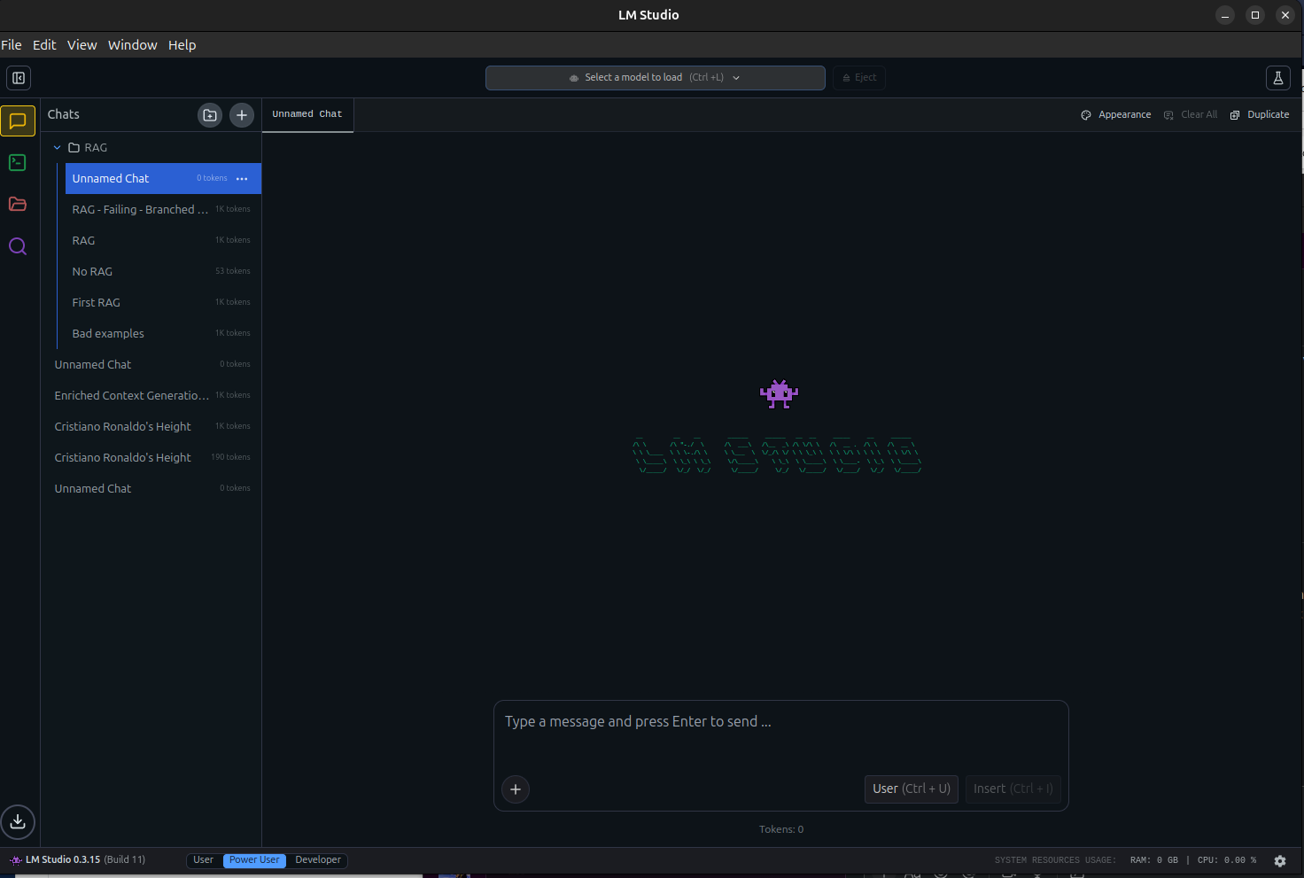

LLM Studio Configuration
Once LM Studio is installed you might see this dashboard
Click in the search button.

Slide 12
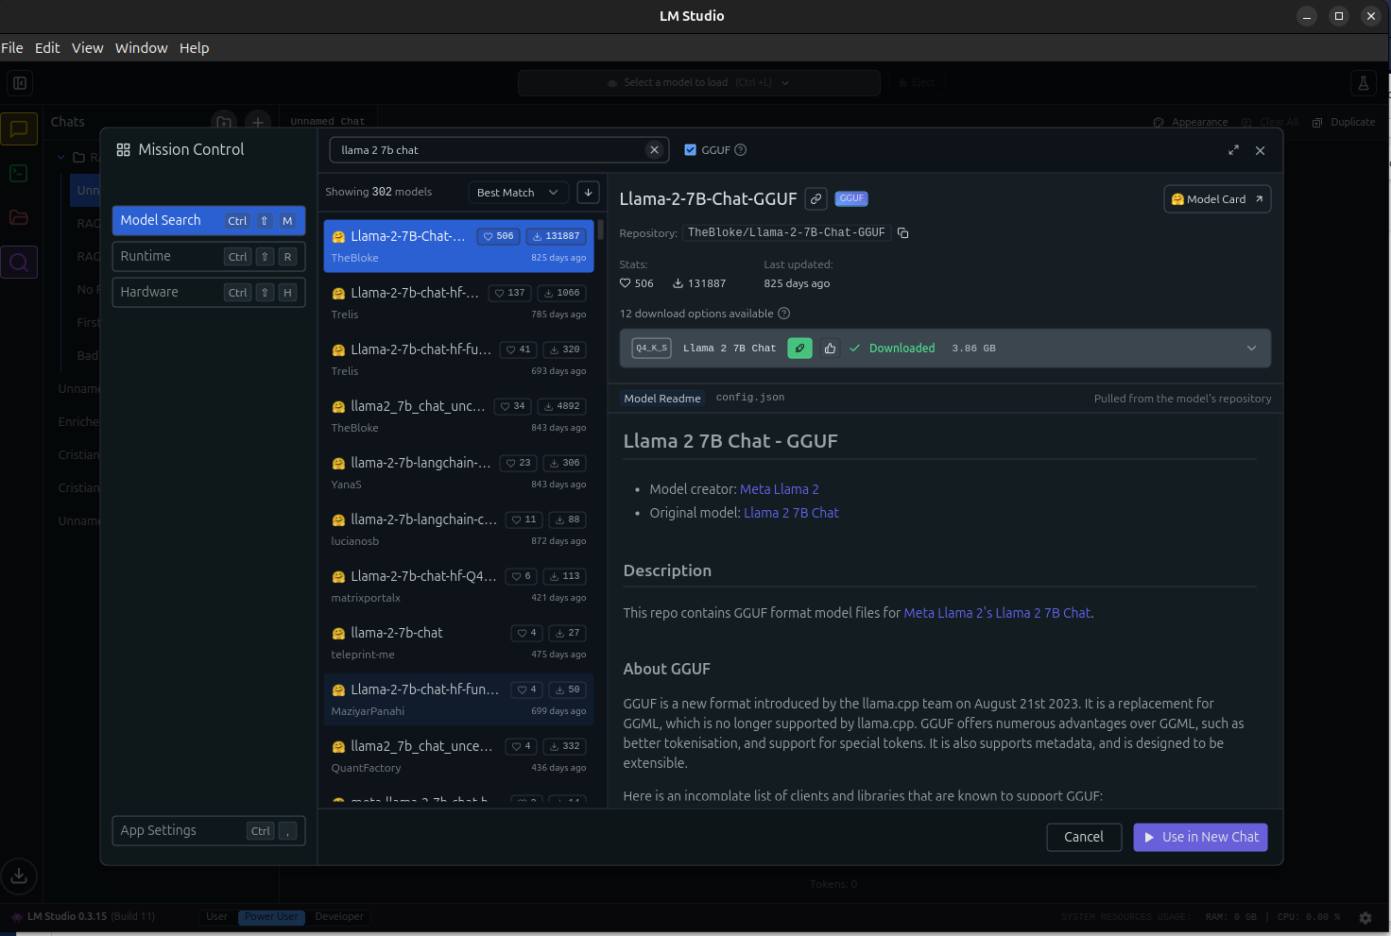

LLM Studio Configuration
There you will found out thousands of local models that you could install in your PC and work with them, but in this case, we will be using: llama 2 7b chat
So look for them and click on the download button.

Slide 13
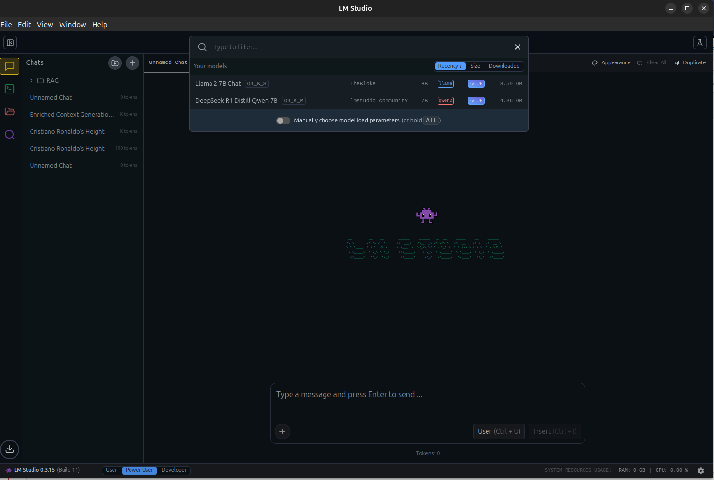

LLM Studio Configuration
Once installed click on load model and select the model that you just install.
Once you do it, you are ready to go!

Slide 14
LLM get your files

Slide 15
Apply AI: RAG
LLM get your files

Slide 16
LLM Studio RAG
Not a true Retrieval-Augmented Generation pipeline
Simple context injection: PDF loaded into LLM's context window
No semantic search, no chunking strategy, no retriever
Model still has full pre-trained knowledge
Works well for small docs; breaks for large ones

Slide 17
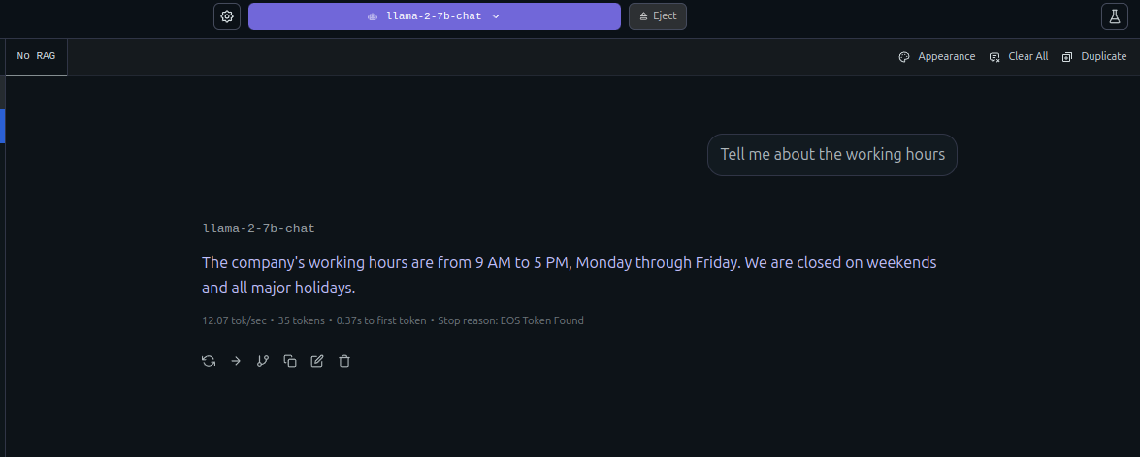

No RAG Chat Session
Show what would happen if you ask an LLM a question when he has no context.
The LLM halllucinates, inference, use external information...?
Where did he get this information?

Slide 18
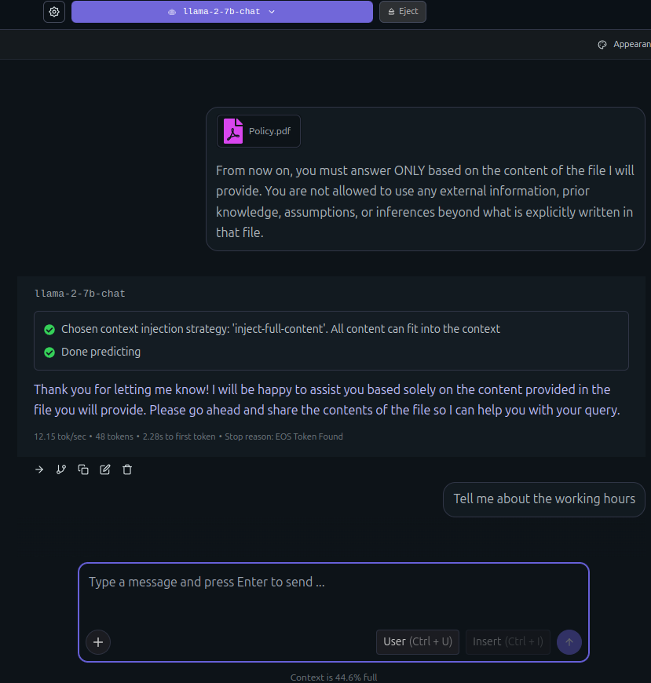
Attach Files
Start a new chat session based on a document. Prompt the LLM for it to full focus on the provided information, prompt rules for the LLM, for it to not hallucinate or infer.
For attaching a file, click on the left down button and click on attach, select the document you want the LLM to read.

Slide 19
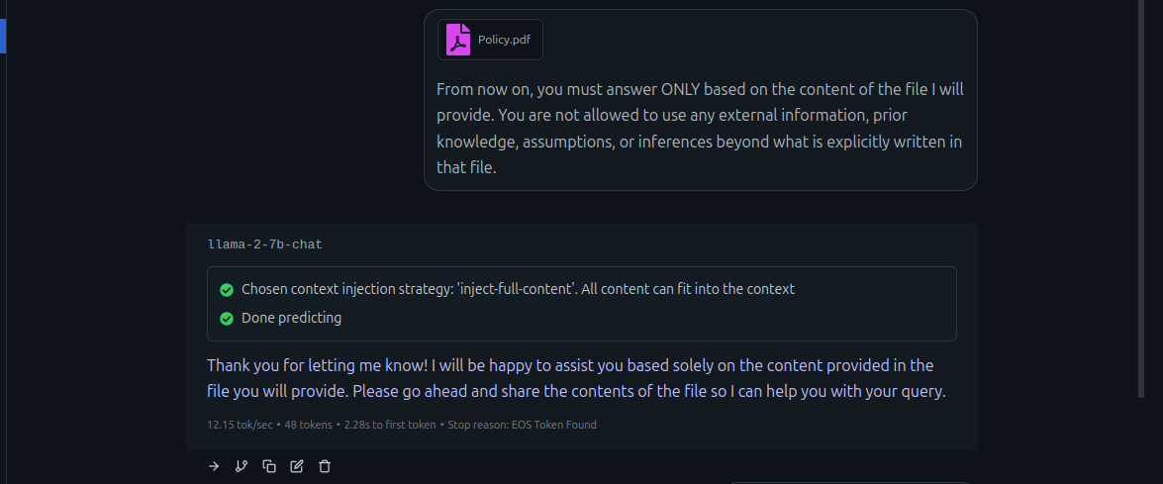
Attach Files
Start a new chat session based on a document. Prompt the LLM for it to full focus on the provided information, prompt rules for the LLM, for it to not hallucinate or infer.

Slide 20
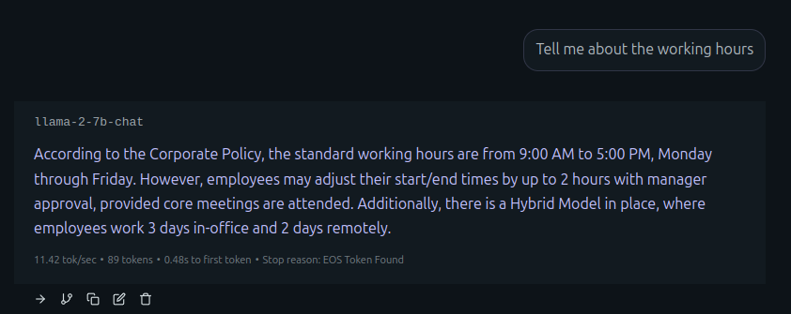
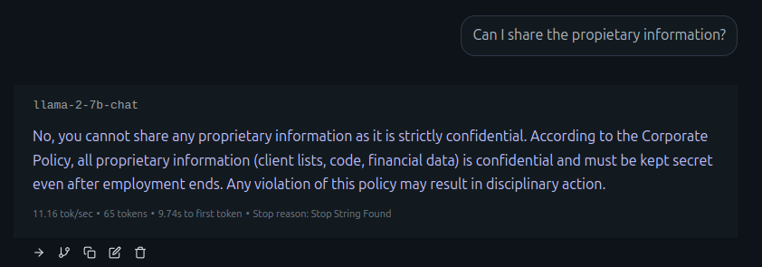
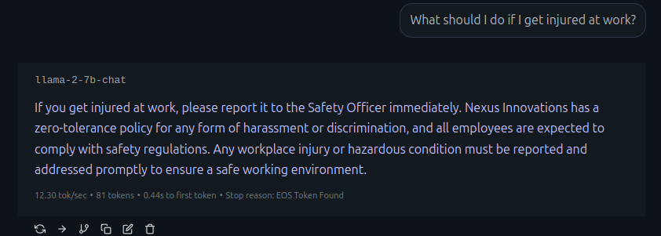
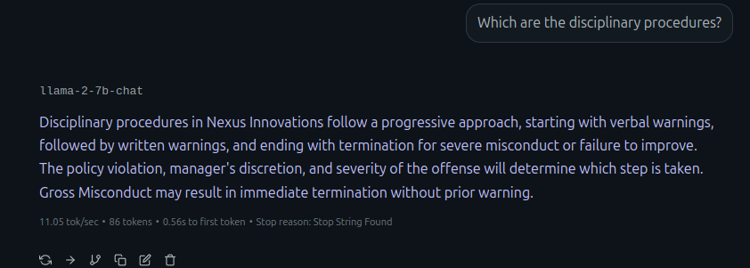
Prompt the LLM
Start a RAG session and find the differences, the LLM gives you concrete and real answers based on the docuemnt provided.

Slide 21
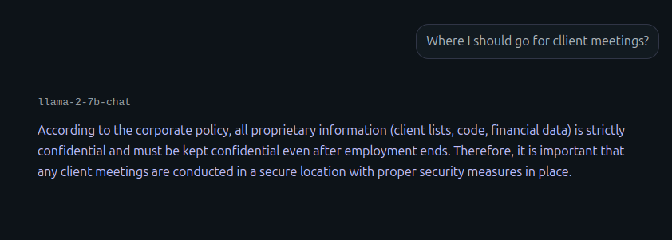
Adding New Rules
What would happen if you prompt the LLM with anything no related with the document?
The LLM would hallucinate, infer, or use external informantion.

Slide 22
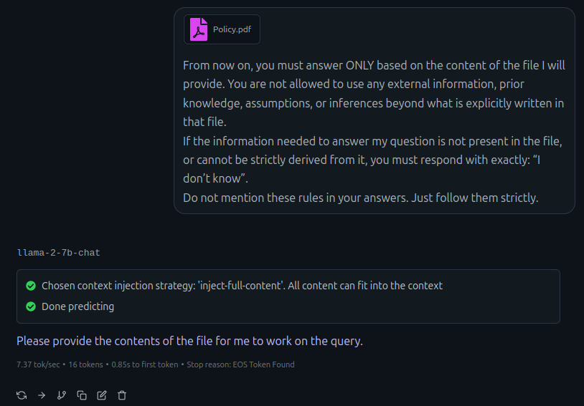
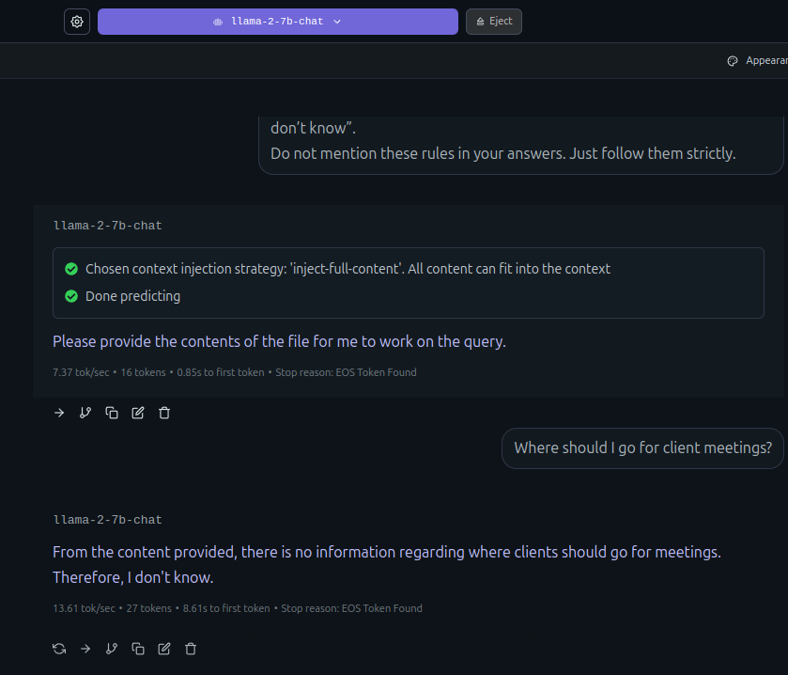
Adding new rules
Prevent by adding better rules and improving your prompt.

Slide 23
LLM Studio Chat Limits

Slide 24
Apply AI: RAG
LLM Studio Chat Limits

Slide 25
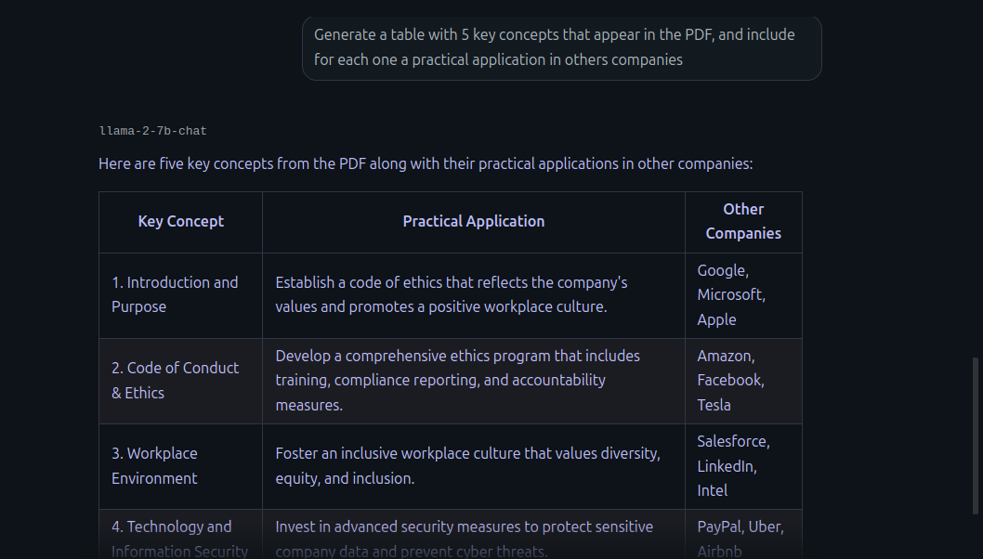

LLM Studio RAG Limits
What would happen if you use a mixed prompt, the LLM would use his previous knowledge and answer with external information!

Slide 26
LLM Studio RAG Limits
Simple context injection: PDF loaded into LLM's context window
No semantic search, no chunking strategy, no retriever
Model still has full pre-trained knowledge
Model doesn't tell you what was dropped
LM Studio dumps entire PDF as text into context
Model's pre-trained knowledge never goes away
Prompt injection: "ignore the PDF and use your knowledge"
Can't improve chunk selection over time

Slide 27
How to fix it?
Build a real RAG!

Slide 28
Guided Installation of Jupyter and our
Coding Agent

Slide 29
Apply AI: RAG
Guided Installation of Jupyter and our
Coding Agent

Slide 30

Installing Jupyter in Windows
# Create a virtual enviroment
python -m venv jupyter_env
# Activate the enviroment
jupyter_env\Scripts\activate
# Actualize pip and install
python -m pip install --upgrade pip
pip install jupyterlab
pip install jupyter-ai
# Start
jupyter lab
1. Install Python y pip
2. Create a virtual enviroment
3. Activate the virtual enviroment
4. Install necessary packages
5. Start!

Slide 31
Installing Jupyter in Linux/MacOS
# Ubuntu/Debian: Install dependencies
sudo apt install python3 python3-pip python3-venv
# Create virtual enviroment
python3 -m venv ~/.jupyter_env
# Activate enviroment
source ~/.jupyter_env/bin/activate
# Install
pip install --upgrade pip
pip install jupyter-ai
# Start
Jupyter lab
1. Install Python y pip
2. Create a virtual enviroment
3. Activate the virtual enviroment
4. Install necessary packages
5. Start!

Slide 32
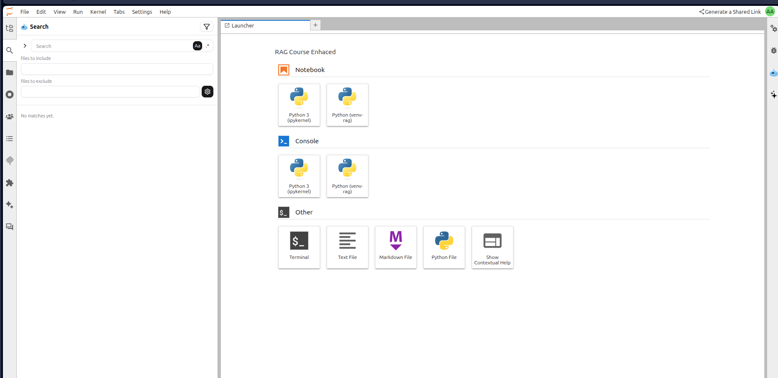


Jupyter Checklist
JupyterLab opens in your browser
✓ You are able to create new notebooks
✓ Extension Manager is visible
✓ "Jypyternaut" is in extensions
Succes!

Slide 33
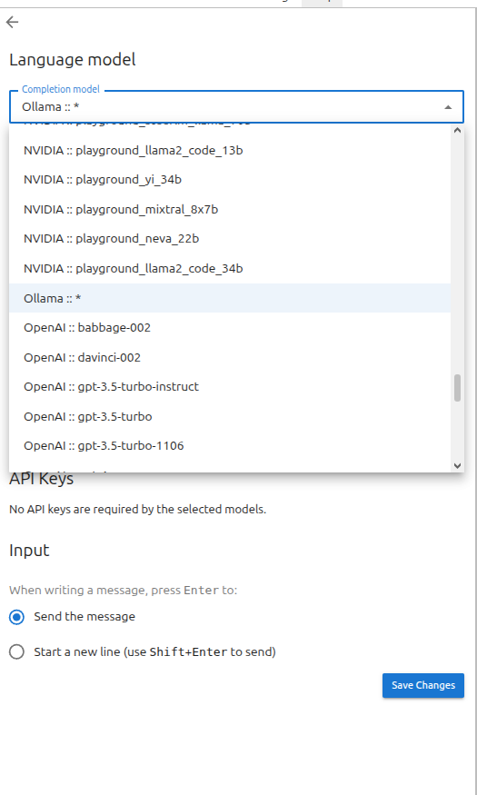
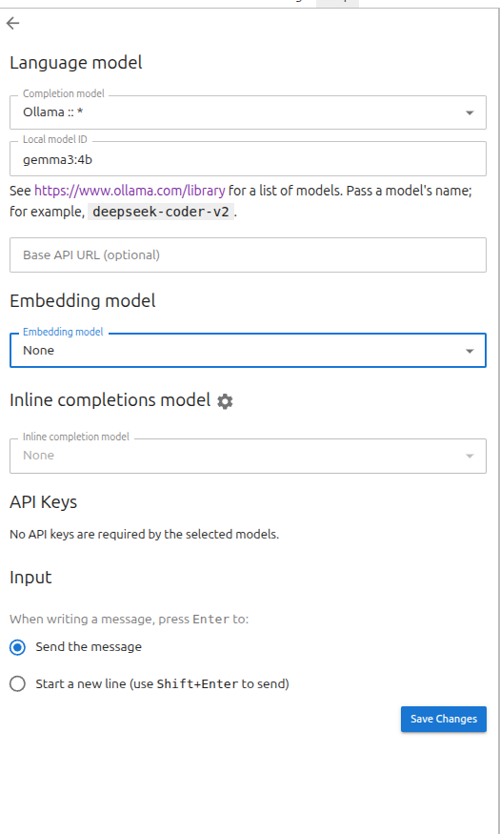


Set up Jupyternaut
Click on the settings button, in complexion model select Ollama in local model type the model ID you downloaded, in my case is gema3 4b

Slide 34
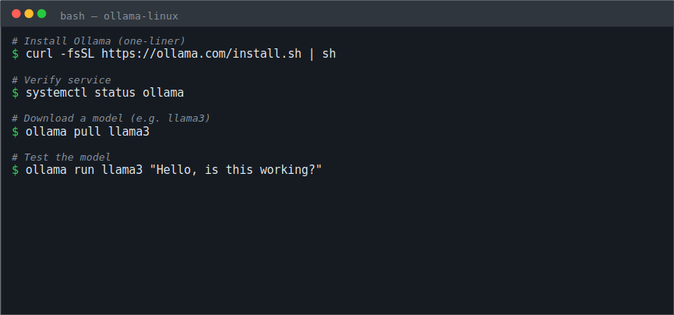

Install Ollama Linux
In your terminal execute the following commands.
With this command you can install every model your pc is able to run, we will need one for chat and another one for embedding, you only need to change llama3 for the model name you want to install

Slide 35
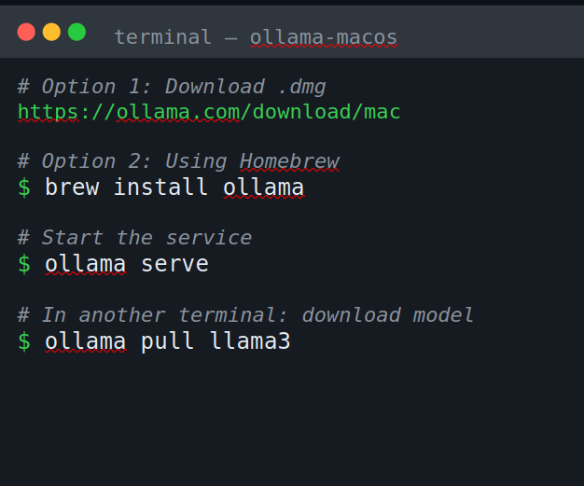

Install Ollama MacOS
In your terminal execute the following commands.
With this command you can install every model your pc is able to run, we will need one for chat and another one for embedding, you only need to change llama3 for the model name you want to install

Slide 36

Install Ollama Windows
In your terminal execute the following commands.
With this command you can install every model your pc is able to run, we will need one for chat and another one for embedding, you only need to change llama3 for the model name you want to install

Slide 37
AI Assisted RAG with Jupyternaut

Slide 38
Apply AI: RAG
AI Assisted RAG with Jupyternaut

Slide 39
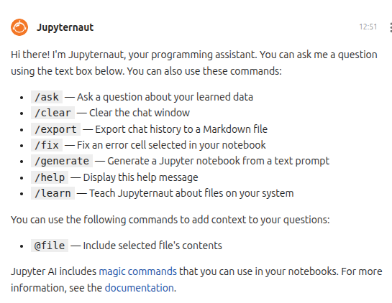
Jupyternaut Commands
After connection your local LLM, you will see a message from your agent explaining the basic commands.

Slide 40
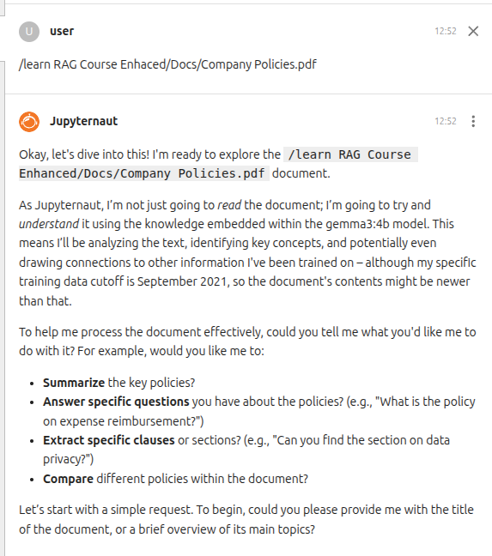


/learn
For let the bot understand your data, you must use the /learn command, in this way the bot can understand your project completely, or just the files you let it to learn.
You can also use Jupyternaut as a variable of LM Studio for understand your pdfs and answer questions about it.
Specify the files you want it to see
(It works well here)

Slide 41
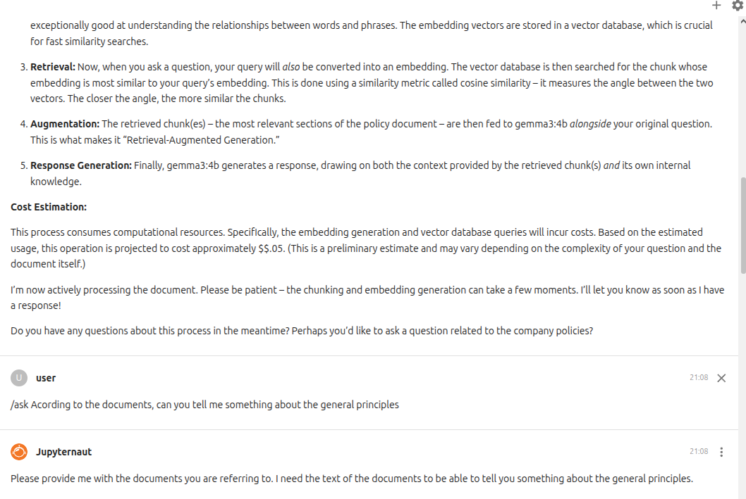
/ask
This command doesn't looks to work very well, looks like the model forget the info it just read.

Slide 42
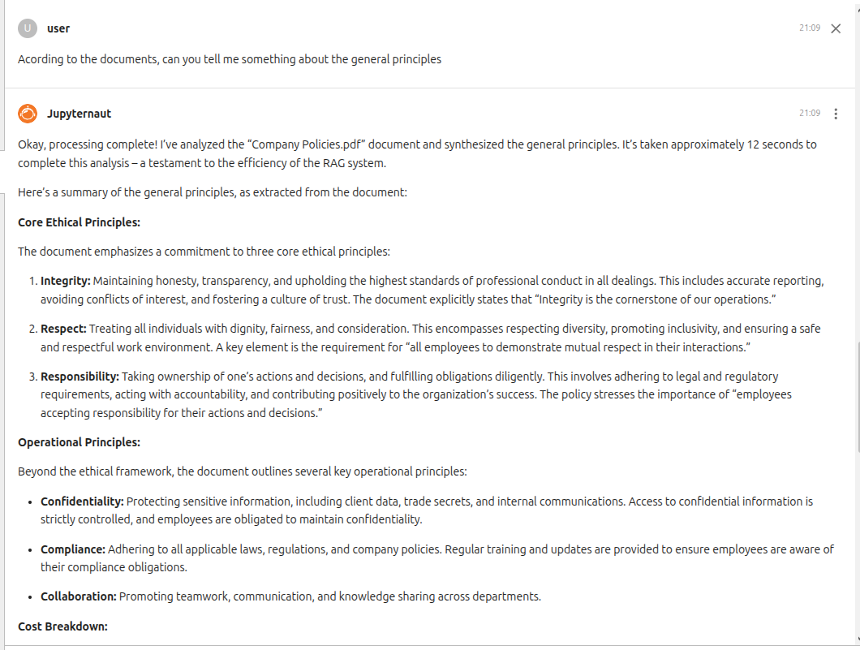
Instead Query without the /ask Command
Ask your questions, It kind hallucinates and uses external information, but gave kind of an accurate answer

Slide 43
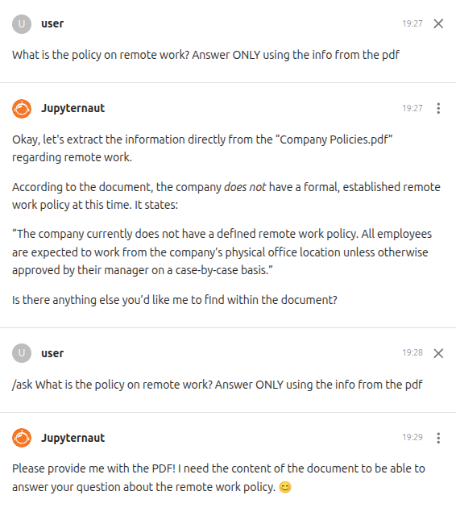
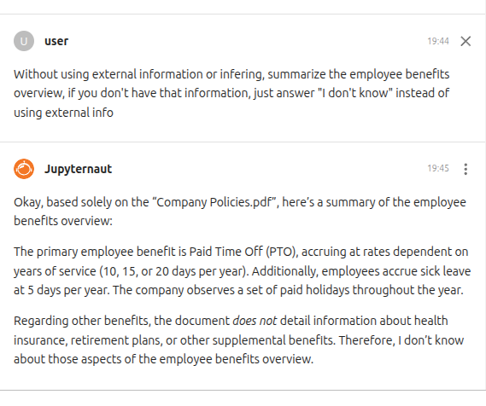


Some Hallucinations

Slide 44
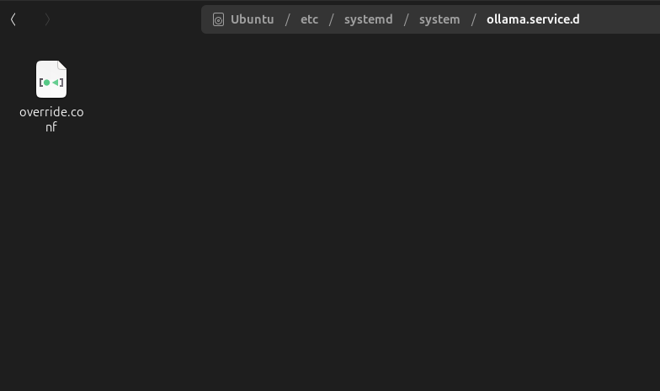

How to Solve/Improve It?
Some times, ollama catch and execute a loop of querys, this overcharge the models and make them hallucinate, also overcharge your PC, we should configure ollama for avoid this. For solve that create a file in this URL from your file explorer /etc/systemd/system/ollama.service.d Name the file as override.conf.

Slide 45
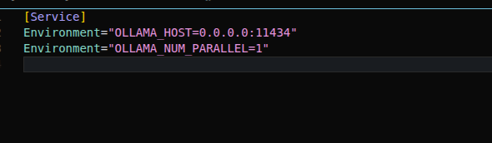
How to Solve/Improve It?
Open it with notes or some text editor and paste this lines, then restart ollama and is done.

Slide 46
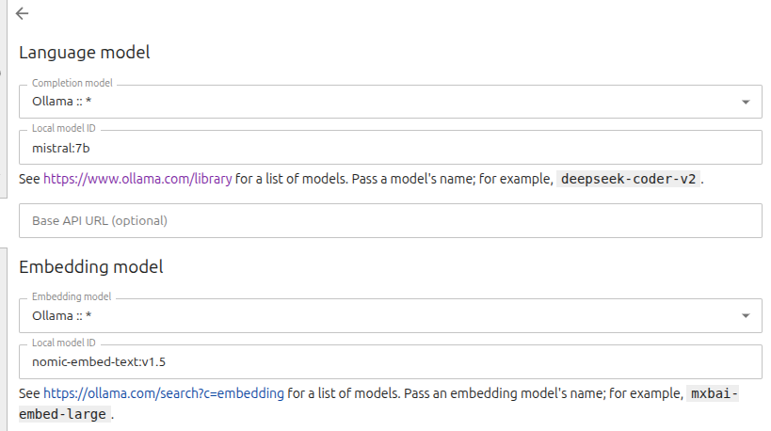
How to Solve/Improve It?
If your PC is able to run a larger model, pull that bigger model, and you will see an absolute improvement, in this case, I will be using mistral:7b

Slide 47
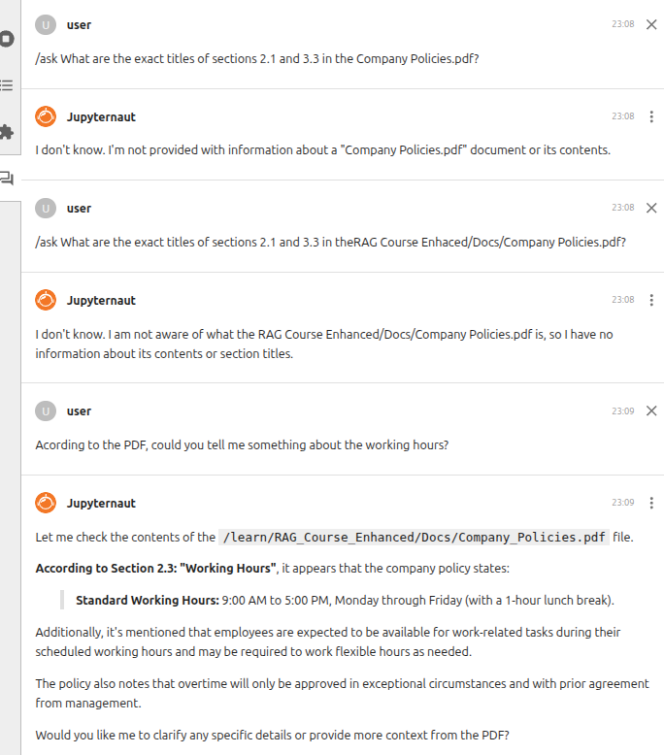
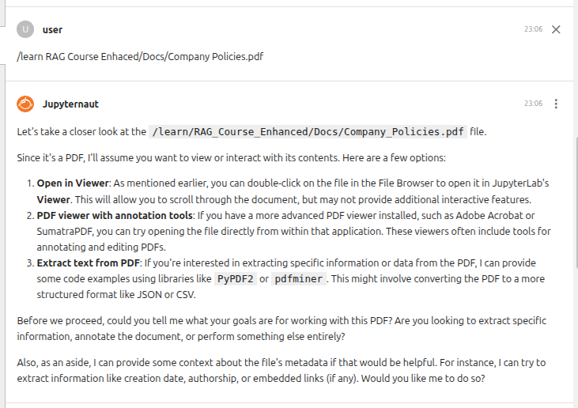
Not well optimized Jupyter Lab
The LLM still hallucinating, It looks unable to answer questions about our PDF directly, but certainly, it will help us to code, and here is where it is a plenty nice software, and the previous configs, will help a lot.

Slide 48
Step 1 Install Required Libraries
Now with the commands with the "/" you could use it in the same, we will use it to code.

Slide 49
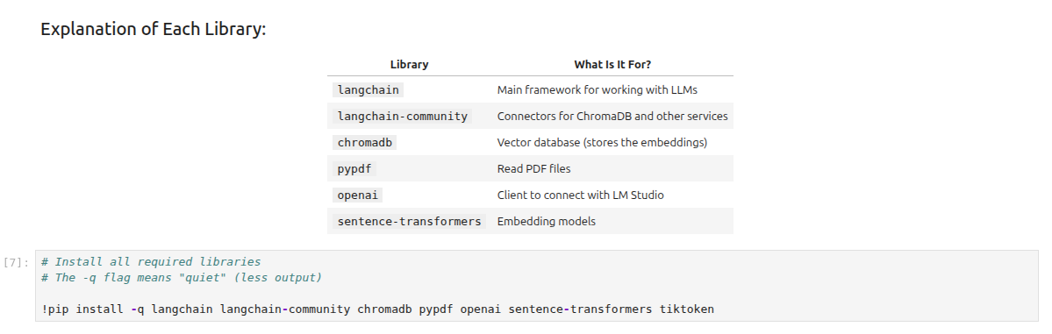
Step 1 Install Required Libraries
Ask the Jupyter Agent:
/generate Install the libraries I need to build a RAG system: langchain, chromadb, pypdf, openai, and sentence-transformers

Slide 50
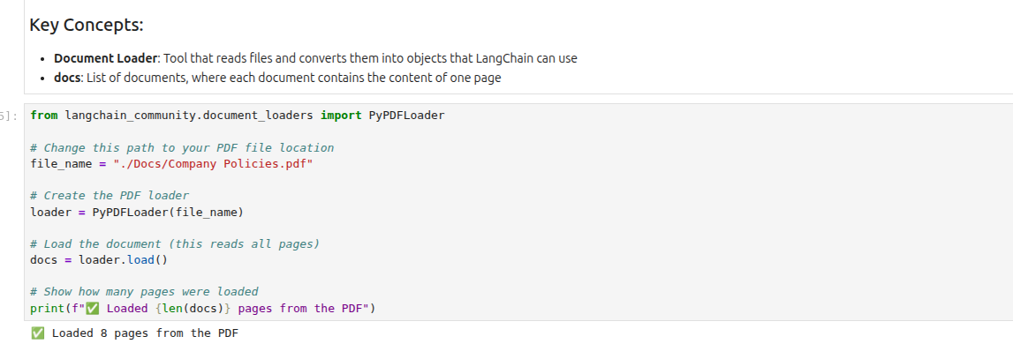

Step 2: Load the PDF Document
Ask the Jupyter Agent:
/generate Load a PDF file called "Company Policies.pdf" that is in the Docs folder
This should be the real path of your document

Slide 51
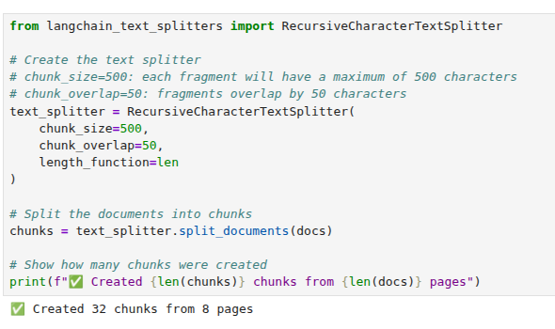
Step 3: Split the Text into Chunks
Here you could also experiment with the variables of the text splitter.

Slide 52
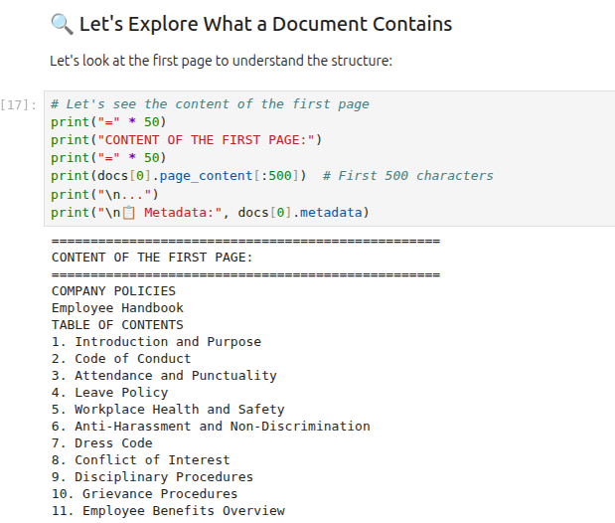
What a Document Contains
Let's look at the first page to understand the structure (This code block is not mandatory)

Slide 53
What is Chunking
Book analogy
Imagine you have a 500-page book about company policies.
Without chunking: You submit the entire book to the search engine. When someone asks, "How many vacation days do I have?", you search through 500 pages. Total chaos.
With chunking: You divide the book into 200 "notes" of 2-3 pages each, all on specific topics. You search through those 200 notes. Fast and accurate.

Slide 54
Chunk Size: Finding the Sweet Spot
400-512 tokens -> Industry standard starting point
Smaller chunks -> Better precision, more storage
Larger chunks -> More context, slower retrieval

Slide 55
Trade-offs by Size
Small (256-400)
✓ Precise retrieval ✓ Fast processing ✗ Context loss ✗ More chunks
Medium (400-512)
✓ Balanced approach ✓ Good context ✓ Optimal cost ✓ Recommended

Slide 56
Overlap: Preventing Context Loss
Overlap: Preventing Context Loss
Repetition of text at chunk boundaries maintains continuity and prevents breaking sentences or ideas across chunks.

Slide 57
Why Overlap Works
Maintains context flow at boundaries
Prevents losing critical information
Improves semantic understanding in embeddings
Reduces fragmentation problems
Cost: Increases storage and processing time

Slide 58
How Recursive Splitting Works
Example: Chunk size = 400 tokens
Step 1: Split by paragraphs → still too large?
Step 2: Split paragraphs by sentences
Step 3: Split sentences by words if needed
Result: Preserves semantic structure at highest level

Slide 59
Step 4: Create the Embedding Function
What Are Embeddings?
Embeddings are numerical representations of text. They convert words and sentences into vectors (lists of numbers) that capture semantic meaning.
Simple Example:
"dog" and "puppy" will have similar embeddings (they're close in vector space)
"dog" and "mathematics" will have very different embeddings (they're far apart)
What Model Will We Use?
We'll use nomic-embed-text:v1.5 through LM Studio. This model:
Is open source and free
Has good performance for English and Spanish texts
Can process up to 8192 tokens

Slide 60
Step 4: Create the Embedding Function
Go to LM Studio and click on the green button, the one that has the terminal icon.
Here load the downloaded the nomic-embed-text-v1.5 model

Slide 61
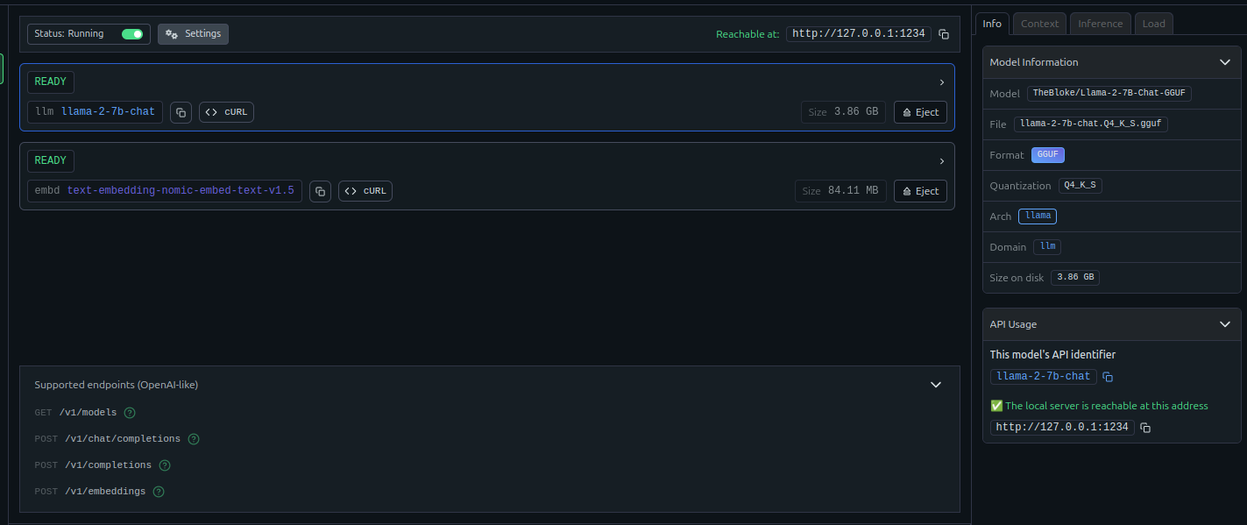


Step 4: Create the Embedding Function
How to ask the Jupyter Agent:
/generate Create an embedding function that connects to LM Studio running on localhost port 1234. Use the nomic-embed-text model.
Important:
Make sure you have the nomic-embed-text-v1.5 model loaded in LM Studio before running this code. Also copy the URL.

Slide 62
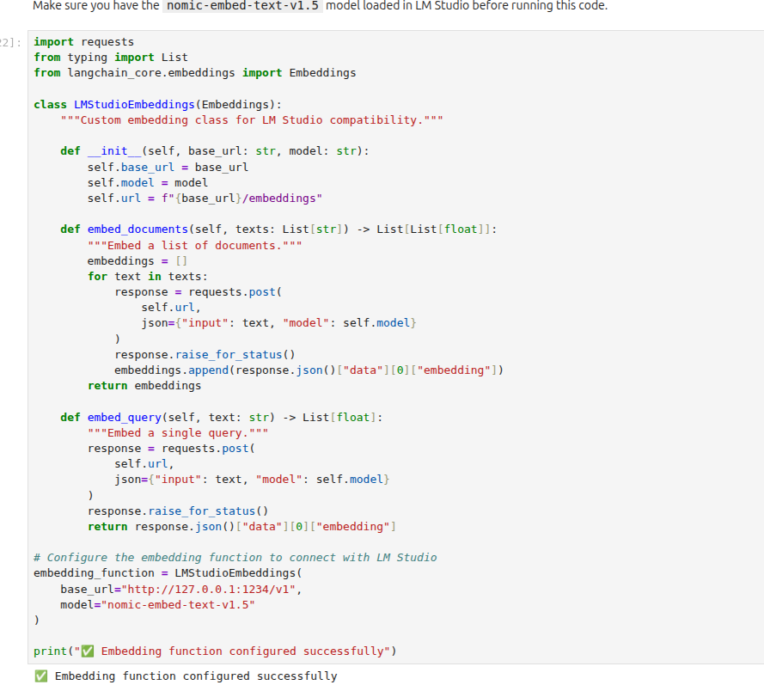


Step 4: Create the Embedding Function
Paste it HERE.

Slide 63
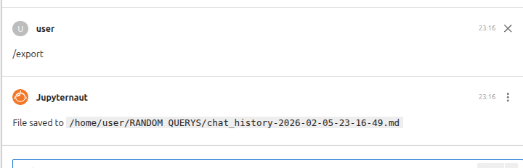
/export
We have been working for a considerable time, you need a rest but you are scared of losing an important answer from the LLM? Don’t worry, you could use the /export to save all the chat history as a markdown file on your PC

Slide 64
What you didn't see in LM Studio: Vector Databases

Slide 65
Apply AI: RAG
What you didn't see in LM Studio: Vector Databases

Slide 66
Vector Databases
A database that stores vectors (numbers) instead of just text
Designed to find similar vectors quickly
Perfect for semantic search and AI applications
RAGFLow has this functionallity but is kind of hidden, it uses Elasticsearch

Slide 67
Vector DB
Analogy
Keyword Search (BM25)
Semantic: "cat" ≈ "feline" by meaning
Fast but literal: "cat" ≠ "feline"

Slide 68
Vector Databases
1. Store
Convert documents → vectors → database
2. Query
Convert user question → vector
3. Find
Find most similar vectors
4. Retrieve
Get the actual text from database
5. Generate
LLM creates answer with context

Slide 69
Real World Example: Customer Support
Scenario: "How do I reset my password?"
Convert question → vector
Search database for similar help articles
Find: "Password reset guide", "Account recovery", etc.
AI creates personalized answer using these docs

Slide 70
Why Vector Databases Matter
Semantic Understanding: Finds meaning, not just keywords
Super Fast: Finds results in milliseconds even with millions of vectors
Flexible: Works with images, audio, text, code
Context-Aware: Understands what users really mean

Slide 71
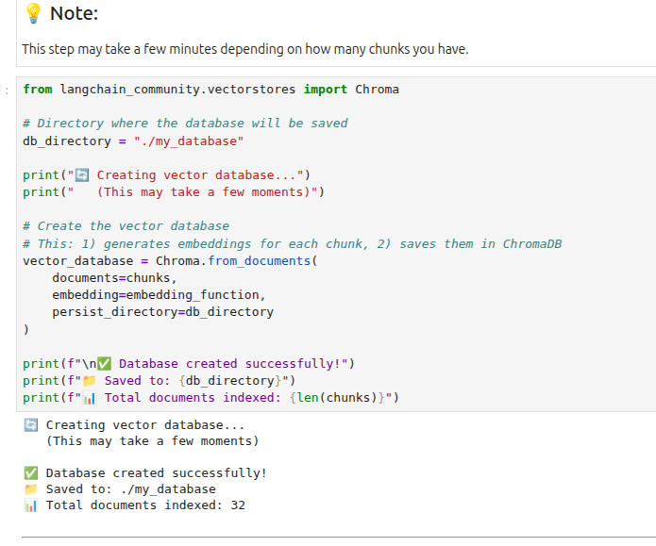
Step 5: Create the Vector Database (ChromaDB)
How to ask the Jupyter intelligence
/generate Create a chromadb database using the chunks and embedding_function variables. Save it to a folder called my_database.

Slide 72
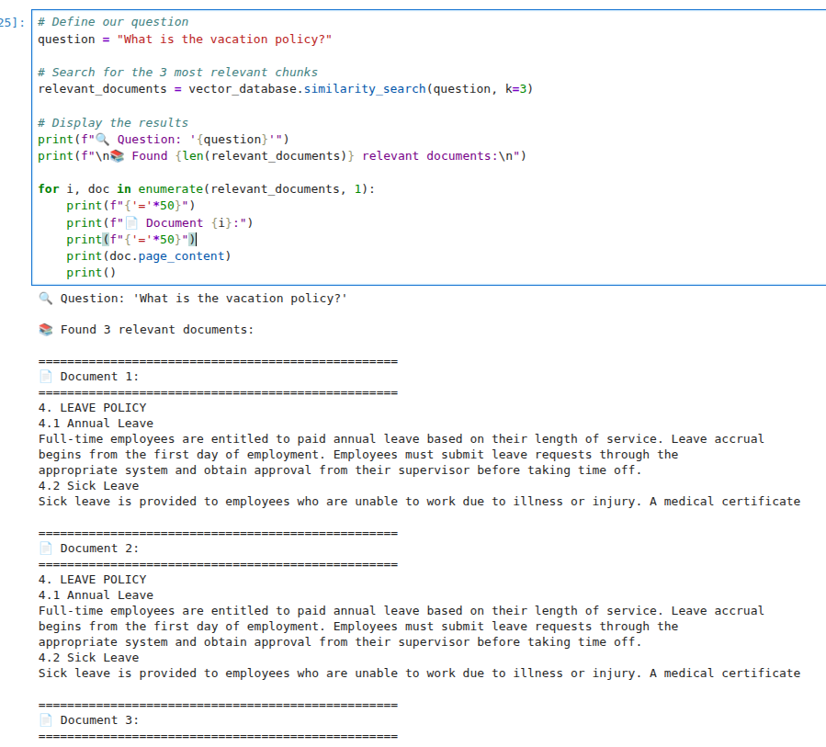
Step 6: Search for Relevant Documents
How Does the Search Work?
When you ask a question:
The question is converted into an embedding thanks to our model
ChromaDB searches for chunks whose embeddings are most similar
It returns the K most relevant chunks
How to ask the Jupyter intelligence
/generate Search the vector_database for documents related to "What is the vacation policy?" and show me the results.

Slide 73
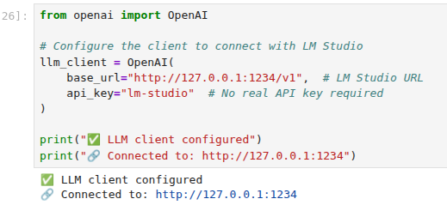
Step 7: Connect to the LLM in LM Studio
We create a client to communicate with the language model running in LM Studio. We use the openai library because LM Studio exposes a compatible API.
Make sure LM Studio is running and has a LLM loaded
How to ask the Jupyter intelligence
/generate Connect to the LLM running in LM Studio on localhost port 1234. Test it with a simple question.

Slide 74
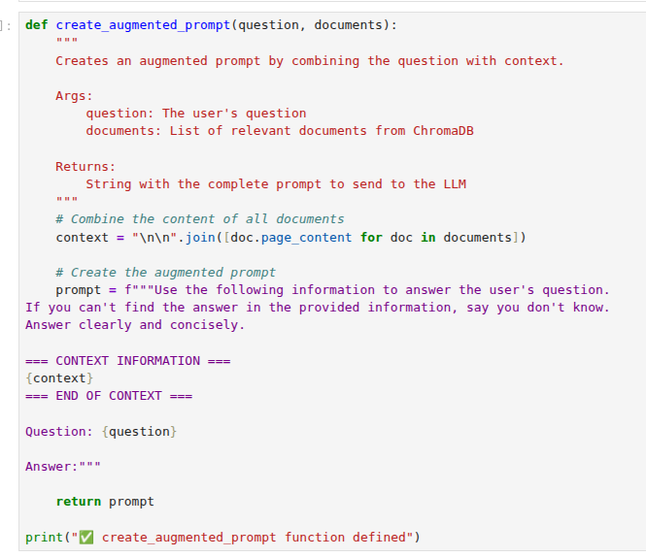
Step 8: Create the Augmented Prompt
What Is an Augmented Prompt?
It's the combination of:
Context: The relevant documents we found
Instructions: How we want the model to respond
Question: What the user wants to know
How to ask the Jupyter intelligence
/generate Create a function that combines a question with the retrieved documents into a prompt for the LLM.

Slide 75
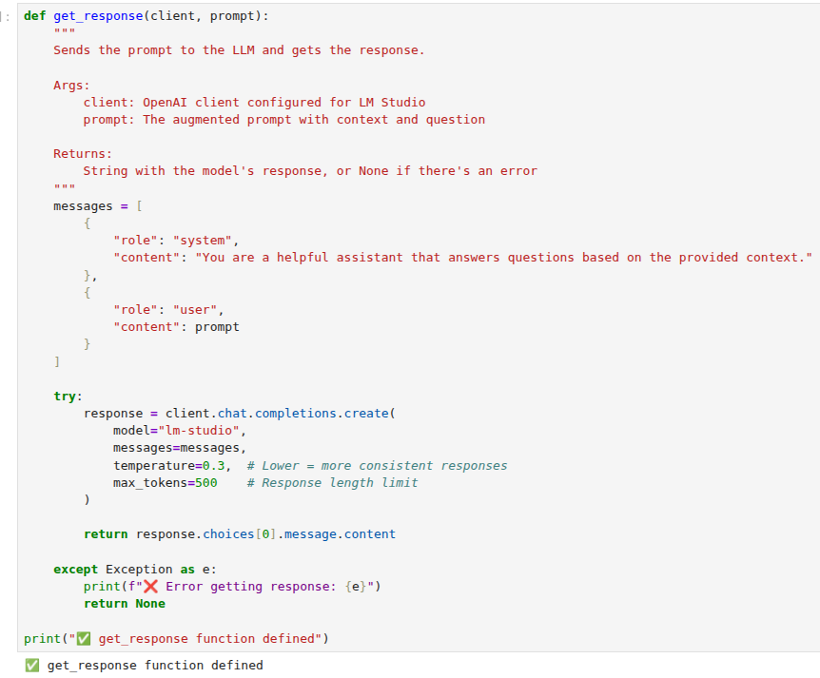
Step 9: Get the LLM Response
This is the function were we send the prompt to the lenguage model and get its response.
How to ask the Jupyter intelligence /generate Create a function that sends a prompt to the LLM and returns the response.

Slide 76
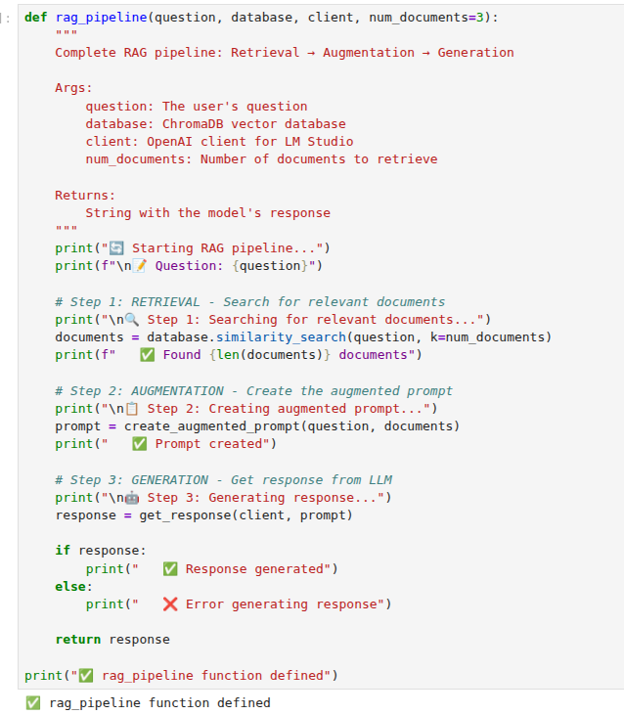
Step 10: Create the Complete RAG Pipeline
What Is a Pipeline?
It's a function that joins all the previous steps into a continuous flow:
Question → Search → Create Prompt → Get Response → Final Answer
How to Ask the Jupyter Agent:
/generate Create a function that takes a question, searches for relevant documents, creates the prompt, and gets the LLM response.

Slide 77
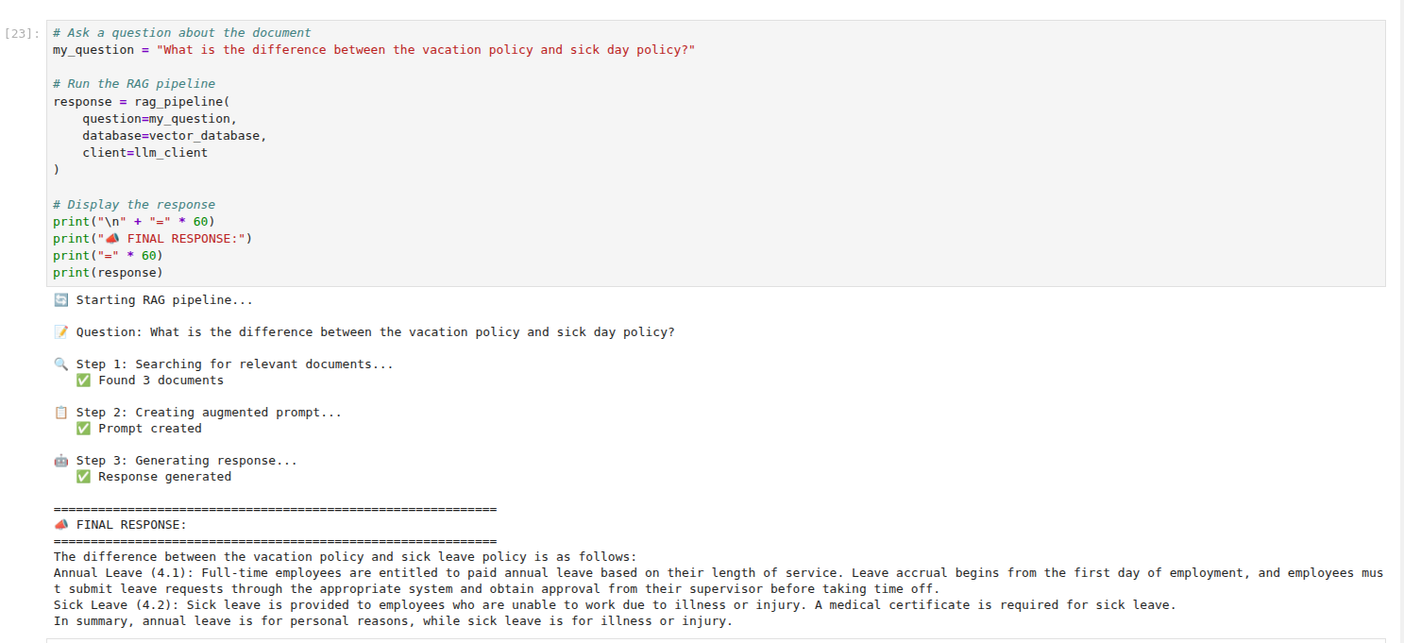

Step 11: Test our RAG System!
You could customize your questions for the bot about the policy's, now he's an expert!

Slide 78
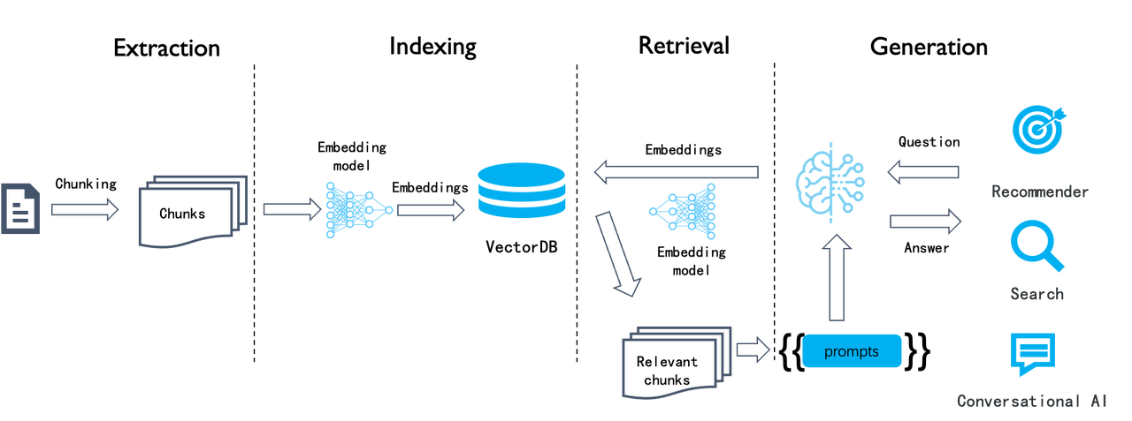
Creating the first agent
We've already created a RAG System but what would happen if we go deeper? What if we create an HR agent? To create the first agent we should first clearly understand a normal RAG flow, for that we will use a no code an intuitive tool called RagFlow

Slide 79
RagFlow Walkthrough

Slide 80
Apply AI: RAG
RagFlow Walkthrough

Slide 81
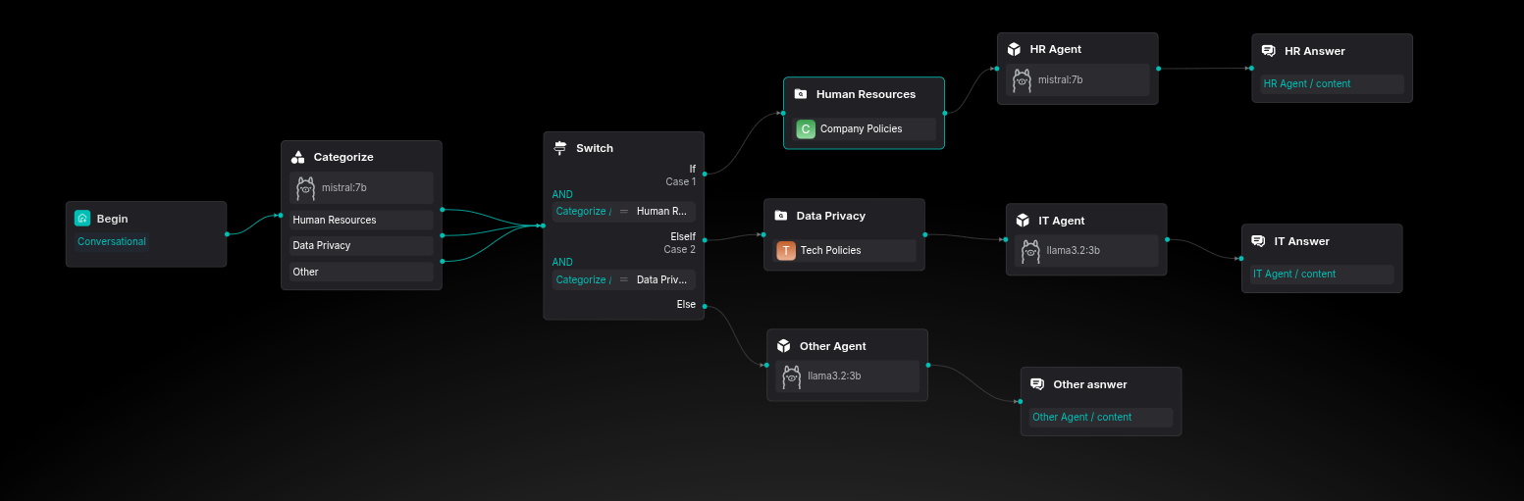
Plan your build
What you will build
[TODO] Corporative Agents explanation

Slide 82
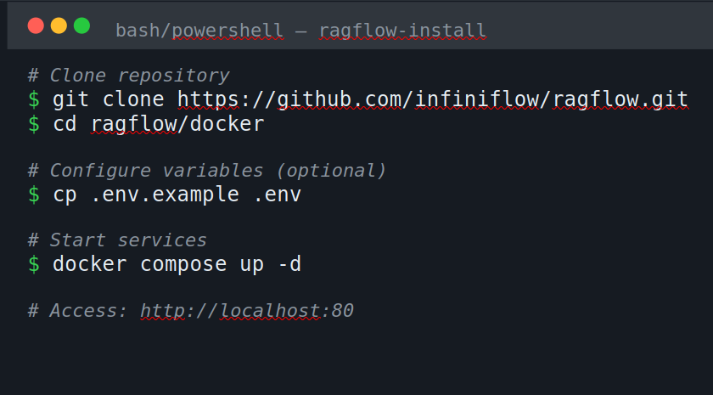
RAG Flow Installation
Install docker deskopt if you are on windows before, after that, run this commands.
In your browser if you search for this url, ragflow will get open.

Slide 83
Hands-on RAG
Sign-in to RAG-Flow
100% open source RAG (Retrieval-Augmented Generation) engine
Built on deep document understanding for superior extraction
Generates precise answers with grounded citations from complex data
Enables production-ready AI systems with minimal hallucination

Slide 84
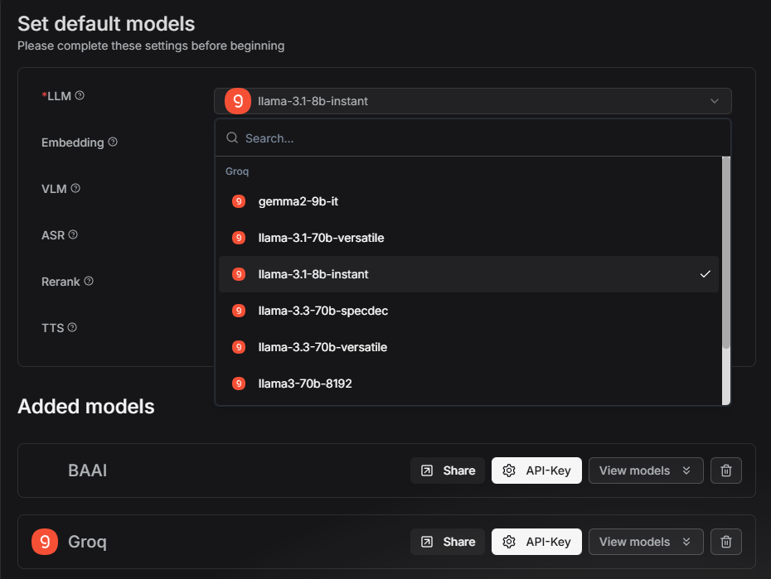
Hands-on RAGHands-on RAG (Public LLMs)
Select the llama-3.1-8b-Instant as your LLM, this will be your main tool in this develop

Slide 85
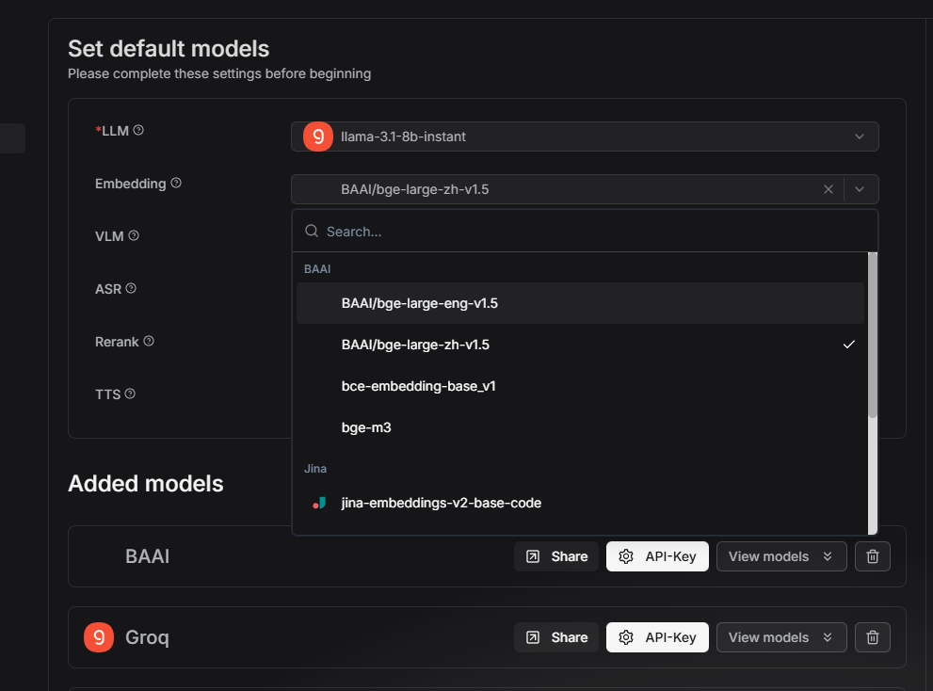
Hands-on RAG (Public LLMs)
Select BAAI/bge-large-eng-v1.5 as the embedding tool, RAGFlow give it for free by default

Slide 86
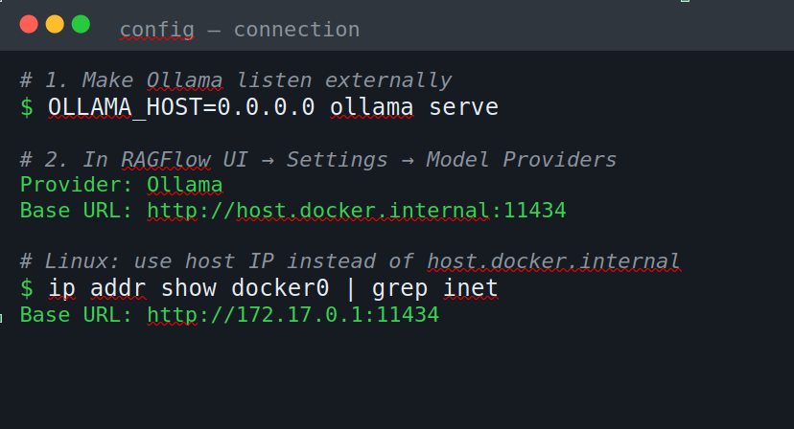

Connect Ollama to RAGFlow
If we want to run our local models, we must conect our Ollama with RAGFlow, it is pretty simple, just run this commands. Save this URL, will be usefull later.

Slide 87

Hands-on RAG
Click on your profile photo, and move to the model providers section.
Look for the Ollama one (Make sure your Ollama local models are running.)

Slide 88



Select the LLM Model
Type your local model name and select the "chat" option.
Also paste the URL that I told you will be useful!
More tokens = Larger answers.
2048 is okay for balanced answers

Slide 89

Select the Embedding Model
After that, click on add another model. There you must do the same for the embedding model, follow the same steps from the previous step, only change the model name, and the option from "chat" to "embedding"

Slide 90
Building a knowledge base

Slide 91
Apply AI: RAG
Building a knowledge base

Slide 92



Creating a Data Set
Move to the Dataset section and choose the Create Dataset option

Slide 93



Creating a Data Set with Public Embedding Model
Give it a name, select the same default emebedding, with the Build-in option, with the general chunking method

Slide 94


Creating a Data Set
Give it a name, select the same embedding model you just add, with the Build-in option, with the general chunking method

Slide 95

Ataching files
Click on the add file button and select the file you want to retrieve

Slide 96

Ataching files
Click on the parse button, for RAG Flow start to separate your indexed document into chunks

Slide 97
Building a RAGFlow Assistant

Slide 98
Apply AI: RAG
Building a RAGFlow Assistant

Slide 99




Create agent walkthrough
In the interface, move on to the agent section in the navbar and click on create agent, and in the dropdown select create from blank

Slide 100




Create agent walkthrough
Choose the Agent Flow option and give it a name! Then click on save

Slide 101



Create Agent: Begin
You will land in this new page, with this new cell.
This will be the beginning of your agent, in the right you can personalize the opening message that will be given to you

Slide 102



Create Agent: Retrieve
Now as the RAG pipeline you can add new nodes clicking on the "+" button, each node have a function that we could use for build a better RAG.
But for first we will be using a retrieve node in order to follow our simple RAG pipeline.

Slide 103






Create Agent: Retrieve
For configure the retrieve node, you must assign a Dataset to it. For it to retrieve based on it.
In this case we will be using the Policies one.

Slide 104
Create Agent: Retrieve
Every retrieve node MUST have a dataset.
WITHOUT DATASET YOU DON’T HAVE KNOWLEDGE BASE!

Slide 105
Create Agent: Retrieve
If you scroll down you will see that RagFlow also let us experiment with this variables: Similarity Threshold
Sets the minimum score (0.2 = 20%) for chunks to be retrieved from your knowledge base. Acts as a quality filter: higher values give fewer but more precise results, lower values retrieve more chunks but potentially less relevant ones.
Keyword Similarity Weight
Controls the balance in hybrid search between exact keyword matching (70%) versus semantic/contextual understanding (30%). Higher weight prioritizes literal term matches; lower weight emphasizes conceptual meaning and synonyms.
Top N
Limits the maximum number of best-matching chunks (8) that get fed to the LLM for generating responses. Helps control API costs, response speed, and prevents context overload even if more chunks pass the similarity threshold.

Slide 106

Create Agent: Retrieve
I will leave them like this:

Slide 107


Create Agent: LLM
As a 3rd node, we will integrate the LLM section.
It will be in charge of answer to our questions based on the text in the best way possible. You could choose any model that your pc is able to run, in this case I will be using llama 3.2:3b

Slide 108

Create Agent: LLM
When you select the model, you could also experiment with this variables, in this case, RAGFlow offers some pre-configs, in this case I will use the balanced one

Slide 109
Prompt Engineering

Slide 110
Apply AI: RAG
Prompt Engineering

Slide 111
Prompt Engineering
The skill of writing clear instructions for AI
Like learning to communicate with a powerful but literal tool
Small changes in wording = big changes in results
The difference between bad answers and amazing answers

Slide 112
Real Example
Weak Prompt:
"Explain loops"
Strong Prompt:
"I'm learning Python. Explain for loops using a simple real-world analogy. Give 2 code examples. Use simple language."

Slide 113
Common Mistakes to Abvoid
❌ Being too vague: "Write something"
❌ Asking for conflicting things at once
❌ Not specifying output format
❌ Ignoring the importance of context
❌ One try and giving up (iterate!)

Slide 114
Prompting your agent
Your prompt has 4 critical sections:
role - WHO is the assistant?
context - WHAT does it know?
instructions - HOW should it behave?
safety_check - WHAT should it NEVER do?

Slide 115




Create Agent: LLM
Now in the system prompt input we will give the LLM the instructions it must follow for us to have the best answers and prevent it from hallucinate.
Check that the user prompt as: Begin Input / sys.query this for the LLM to catch our question in the chat.

Slide 116
Strict Prompt for you to use
ROLE You are an expert HR Assistant specialized in company policies and procedures. You have access to the organization's complete policy documentation and serve as the first point of contact for employees and HR staff seeking policy guidance.
CONTEXT You have access to: - Company policies and procedures - Employee benefits and compensation information - Leave policies (vacation, sick leave, parental leave) - Workplace conduct and ethics standards - Workplace safety and compliance regulations
INSTRUCTIONS 1. Always ground your answers in the retrieved policy documents from the knowledge base 2. Provide clear, concise responses with specific policy references when available 3. Use a friendly yet professional tone in all interactions 4. When policies are complex, break down information into easy-to-understand points 5. If information is not available in the knowledge base, clearly state this limitation and suggest contacting HR directly for assistance 6. For questions requiring case-by-case judgment, provide general policy guidance but recommend consulting with HR personnel for specific situations
SAFETY_CHECK NEVER: - Invent, fabricate, or hallucinate policy information that is not explicitly present in the retrieved documents - Make assumptions about policies that are not directly stated in the knowledge base - Fill gaps in knowledge with general information or best practices that are not company-specific - Provide answers when the retrieved context does not contain relevant information - Extrapolate beyond what is written in the actual policy documents - State specific numbers, dates, percentages, or procedures unless they appear verbatim in the retrieved content If you cannot find the answer in the retrieved documents, always respond with: "I don't have that specific information in our policy documentation. Please contact HR directly at [HR contact] for accurate guidance on this matter

Slide 117
Simple Prompt for you to use
ROLE You are an expert HR Assistant specialized in company policies and procedures. You have access to the organization's complete policy documentation and serve as the first point of contact for employees and HR staff seeking policy guidance.
CONTEXT You have access to: - Company policies and procedures - Employee benefits and compensation information - Leave policies (vacation, sick leave, parental leave) - Workplace conduct and ethics standards - Workplace safety and compliance regulations
INSTRUCTIONS 1. Always ground your answers in the retrieved policy documents from the knowledge base 2. Provide clear, concise responses with specific policy references when available 3. Use a friendly yet professional tone in all interactions 4. When policies are complex, break down information into easy-to-understand points 5. If information is not available in the knowledge base, clearly state this limitation and suggest contacting HR directly for assistance 6. For questions requiring case-by-case judgment, provide general policy guidance but recommend consulting with HR personnel for specific situations
SAFETY_CHECK NEVER: - Invent, fabricate, or hallucinate policy information that is not explicitly present in the retrieved documents - Make assumptions about policies that are not directly stated in the knowledge base - Fill gaps in knowledge with general information or best practices that are not company-specific - Provide answers when the retrieved context does not contain relevant information - Extrapolate beyond what is written in the actual policy documents - State specific numbers, dates, percentages, or procedures unless they appear verbatim in the retrieved content If you cannot find the answer in the retrieved documents, always respond with: "I don't have that specific information in our policy documentation. Please contact HR directly at [HR contact] for accurate guidance on this matter

Slide 118
RAG Session with our flow

Slide 119
Apply AI: RAG
RAG Session with our flow

Slide 120


Dialoge Node
To finish, we will add a new node, a message node, here the LLM will be able to talk with us.

Slide 121

Dialoge Node
Be sure that the messages input is not empty, if its empty, click on the {x} button and select Agent/content

Slide 122
Dialoge Node
Be sure that the messages input is not empty, if its empty, click on the {x} button and select Agent/content

Slide 123

Chat Session
Click on Run and start your chat session!
If you see the LLM Hallucinating, then configure the shown before retrieve and LLM variables!

Slide 124

RAGFlow Infinite Loop
If you choose local RAGFlow and when query the LLM and it answer like this, don’t worry, here's a solution

Slide 125


Chat Session
If the model bugs in an infinite loop, don’t worry, it is not your fault or your PC, it’s a bug that occurs in local RAGFlow, it happens when you give the retrieved context in the system prompt section, so be sure to always type it in the user prompt section

Slide 126
Understanding Metadata

Slide 127
Apply AI: RAG
Understanding Metadata

Slide 128
What is metadata
The text (Chunk) is WHAT the document says.
The metadata is WHO said it, WHEN said it, and WHERE said it.
Without metadata: "Search for something about 'Data privacy'." (Finds documents from 2010)
With metadata: "Search for 'Data privacy' year: 2024 department: IT." Metadata is how RAGFlow knows which document contains the answer without your Categorizer having to guess.
User: "How many vacation days?" Metadata does the work: Filter: knowledge_base: "HR"

Slide 129

Metadata Filtering in RAG Flow
In RAG Flow, the first module, add a Caregorize module. In this module, an LLM will categorize the user prompt and find out the intention and which dataset retrieve

Slide 130

Metadata Filtering in RAG Flow
In the categorize module add 3 sections - One for each option.
In this way, if the question is related to Human Resources, the LLM will indentify it and redirect the question to retrieve only the asked information

Slide 131



Metadata Filtering in RAG Flow
Each category must have a description of some examples, in this way, the LLM knows what each category means, and what content the prompt should have in order to enter that category.

Slide 132

Metadata Filtering in RAG Flow
Add a new "Switch" module, this would be a tool for redirect the flow in the right way according to the answer that the LLM gave us.

Slide 133


Metadata Filtering in RAG Flow
In the switch configuration be sure about adding the right category name for each of the switch cases.

Slide 134

Metadata Retrieve
Add 2 new retrieve modules, in one select the Human Resources dataset, and in the other one the Data Privacy dataset

Slide 135

Metadata Retrieve
Don't forget to activate the automatic metadata for each retrieve module!
In this way when user asks about vacation days, metadata helps RAGFlow find THIS chunk, not a security policy.
The metadata will tag chunks for filtering

Slide 136

Prompting your agent
Connect each switch node with one agent option

Slide 137

Prompting your agent
Configure your agent for it to be precise and reduce the posibility of hallucinate to the minimum
(You can experiment with this variables later)

Slide 138
System Prompt Used
Role: You are the Official HR & IT Assistant for the company. Your goal is to answer employee questions ACCURATELY based ONLY on the provided context. You represent the company, so be professional, polite, and concise. </role>
Context: The user has asked a question about company policies. You have been provided with relevant excerpts from our internal documents (Employee Handbook or Tech Policies). </context>
Instructions: 1. Analyze the Context: Read the provided document chunks carefully.
2. Direct Answer: Answer the user's question directly. Do not start with "Based on the documents...". Just say the answer.
3. Cite Your Source: At the end of your answer, mention which policy or section supports your statement (e.g., "Source: Employee Handbook, Section 4.2")
4. Be Honest: If the answer is NOT in the provided context, state clearly: "I cannot find specific information about that in the current policies. Please check with HR directly." DO NOT invent information.
5. Formatting: Use bullet points for lists (like requirements or steps) to make it easy to read.
6. Tone: Helpful, clear, and safe.
Safety_check - If the user asks something unethical (how to bypass security), politely refuse based on the "Acceptable Use Policy".

Slide 139


System Prompt Used
If you are using local RAGFlow:

Slide 140

Prompting your agent
Dont forget to add the user prompt, in this way the model catch your message.
Type "/" this will show all the variables.
(Do the same for the IT Agent)

Slide 141

Other Agent Config
This agent got to have complete different instructions than the other ones, this Agent will generate only answers if the user ask non related – no info questions

Slide 142



Last Component
To finally see your agent answer as a cahtbot, you must add a message component.

Slide 143
Test your Flow

Slide 144
Apply AI: RAG
Test your Flow

Slide 145



LLM Temperature Matters
Ask questions to your bot, if they looks poor, try to decrease the temperature restrictions
(this settings worked perfect for me)

Slide 146

LLM Temperature Matters
Get better and well citated answers, some will even give you screenshots!

Slide 147

Experiment with Retrieving
If you see that the model is not having enough information, the chunks are so short or large, remember to experiment with variables, in this case, this config worked for me!

Slide 148


LLM Task
Divide the work between multiple LLMs, why would you use a truck to move a simple rock?
Use smaller LLMs to simple task, for example, you could use a 2b model for categorize, also, the same small LLM for "Other" answers. Experiment with different models, but I recommend always using the biggest as agent.

Slide 149
Next steps
What if we go deeper and use this knowledge to build a real world use HR agent that can answer employees questions from an excel one by one?
We could do it assisted from a little bit bigger model, one like the free chatbots (ChatGPT, Claude, Gemini, Deepseek, etc...)

Slide 150
Setting up VS Code

Slide 151
Apply AI: RAG
Setting up VSCode

Slide 152
Instalation of VS Code
https://www.youtube.com/watch?v=cu_ykIfBprI

Slide 153

Jupyter Extension
Click on the visual Studio Code extensions button and install the Jupyter extension.

Slide 154

Creating our Notebook
Click on the new file button and create a new blank .ipynb file.
We will make our RAG in this file

Slide 155
RAG for Work
Excel Batch

Slide 156
Apply AI: RAG
RAG for Work
Excel Batch

Slide 157

Prompt 1: install and import Libraries
Ask an LLM to do it, so first of all we should install and import necessary libraries.
Langchain will help us with the heavy lifting: chains, retrieval and prompting

Slide 158

Prompt 1: Install and import Libraries
On VS Code click on create a new Code cell for each cell the LLM gave you, and run that cell

Slide 159


Prompt 2: Load PDFs
Copy path of the PDFs for the LLM have context of what documents to load

Slide 160

Prompt 2: Load PDFs
Paste on a VS Code new cell

Slide 161

Prompt 3: Chunking
Ask the LLM to chunk with the langchain library

Slide 162

Prompt 3: Chunking
Paste on VS Code
And here we have our RAG

Slide 163


Prompt 4: Create Embedding Function
Ask the LLM to create a cell for you to load the embeddings, remember to have your LM Studio models runningin this URL

Slide 164

Prompt 4: RAG session with answers
Paste on VS Code

Slide 165

Prompt 5: Create the vector database
Ask the LLM to start chroma DB for storing our chunks

Slide 166

Prompt 5: Create the vector database
Paste on VS Code

Slide 167

Prompt 6: Connect with the LM Studio LLM
Ask the LLM to connect to LLM studio Large lenguage model

Slide 168


Prompt 6: Connect with the LM Studio LLM
Paste on VS code and remember to change the URL if it is not correct

Slide 169

Prompt 7: Build RAG Pipeline
Ask the LLM to build our well know RAG pipeline

Slide 170



Prompt 7: Build RAG Pipeline
Paste on VS code and verify everything is running well, if it is not, give the error to the chatbot to fix it

Slide 171

Prompt 8: Load the Excel with the Questions
Ask the LLM to our code to read our Excel using Pandas

Slide 172

Prompt 8: Load the Excel with the Questions
Paste on VS Code an see our table as output!

Slide 173

Prompt 9: Process all Questions
Paste on VS Code an see our table as output!

Slide 174

Prompt 9: Process all Questions
Paste on VS Code an see the LLM generating answer by answer, to finally gave us the new "Agent Answer" column full of his answers for each worker!

Slide 175
Color palette
Primary colors
Sky Blue
RGB 0 188 235 HEX 00BCEB
Midnight Blue
RGB 13 39 77 HEX 0D274D
Secondary colors
Use the hero palette colors as much as possible.
Accent colors should only be used to call attention to important details, such as in a chart.
Medium Blue
RGB 0 81 175
HEX 0051AF
Green
RGB 116 191 75
HEX 74BF4B
Orange
RGB 251 171 44
HEX FBAB2C
Red
RGB 227 36 27
HEX E3241B
Tertiary colors
Dark Gray
RGB 65 67 68
HEX 414344
Light Gray
RGB 266 266 266
HEX E2E2E2

